Slide 1
AI NATIVE PLATFORM ENGINEERING
AGENTS AS THE PRIMARY CONSUMER
Presenter: Jeffrey Aven
STACKQL>>
Notes:
Three things today:
StackQL in five minutes
what changes when agents write to your estate
and how to embed the MCP server in a Golang binary

Slide 2
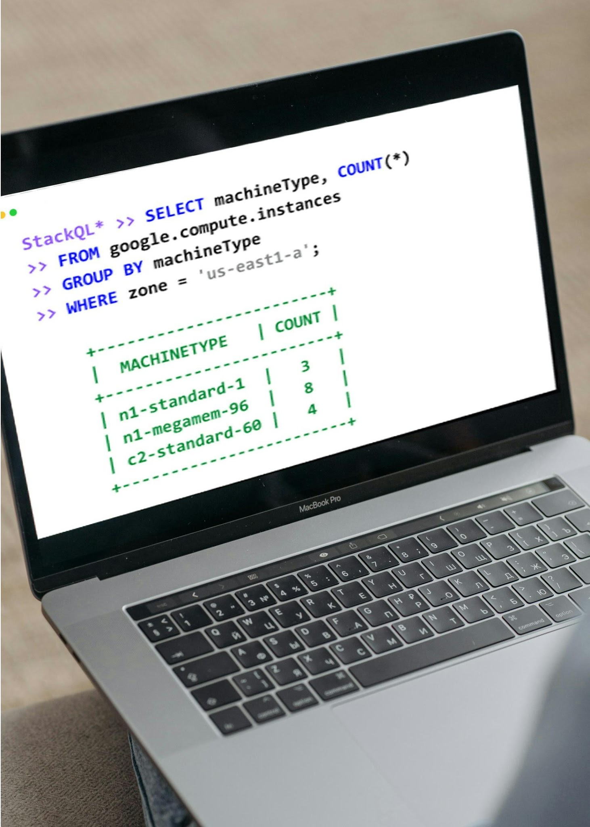


STACKQL >>
Unified Cross-Plane Analytics, Automation and IaC
Query and Interact in Real
Time using SQL
Seamless Integration with
Existing Systems
Analyst Friendly, Agent Native
CONFIGURATION-AS-DATA
INFRASTRUCTURE-AS-CONTEXT
STACKQL>>
Notes:
Cloud and SaaS providers as data sources accessed via SQL.
Query and change live state.
No server, no database, no state file: the engine calls the provider APIs at query time.

Slide 3
START WITH A FAMILIAR INCIDENT
Synthetic fixture - not customer telemetry
OBSERVED STATE
APPROVED DESIRED STATE
shop / checkout
ImagePullBackOff
0 of 1 replicas ready
Current image: :broken
Trusted fixture baseline
Image: :1.2.3
Desired replicas: 1
Evidence must be fresh
The question is not whether the agent sounds confident.
It is what can it actually do?
Read current state > compare approved intent > propose one bounded action
STACKQL>>

Slide 4


IaC/PLATFORM OPS IN THE AGENT ERA
Agents AND humans
author changes.
Humans author the changes.
Changes at human timescales.
Changes at machine speed.
One writer per environment.
Multiple writers, at the same time.
Drift is an exception.
Drift is the default state.
STACKQL>>
Notes:
IaC was based upon four assumptions, all of which were reasonable ten years ago, now all inverted.
Humans authored the changes.
Changes happened at human timescales, which is to say minutes to days.
One writer per environment, enforced by review and state locking.
And drift was an exception, something you fixed and then went back to the steady state.
A state file is a snapshot of one writer's belief.
With multiple writers it is wrong by construction.

Slide 5
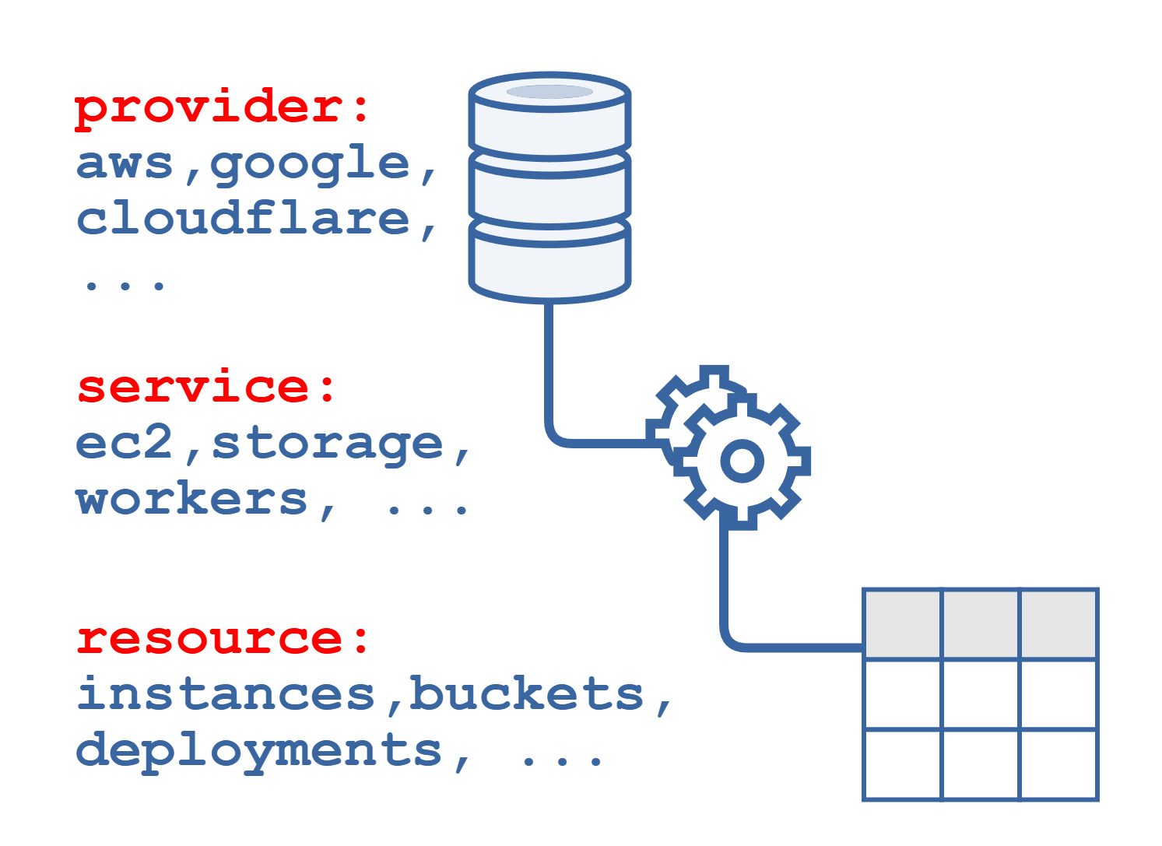
Cloud Providers as Data Sources
Open-Source intelligent API client
Protocol Agnostic
DAG planning for remote and local execution
SQL semantics for Cloud/SaaS Provider APIs
Relational algebra, analytics
CRUD, Discovery and Lifecycle Methods
STACKQL>>
Notes:
Providers are OpenAPI-derived interface documents pulled from a registry; 40+ providers, community extensible.
SELECT for reads, INSERT/UPDATE/REPLACE/DELETE for writes, EXEC for lifecycle methods.
The planner builds a DAG: remote calls where it must, local relational work (joins, aggregates, SQLite functions) where it can.

Slide 6




How to use StackQL
One execution engine. Multiple human/agent consumption patterns.
PATTERN |  | INTERFACE | USERS | KEY BENEFIT
 | Interactive Analytics | stackql shell stackql exec | Engineers, Analysts | Ad-hoc discovery, inventory
 | Application & Data Integration | stackql srv docker pull pystackql | Apps, BI Tools, Python Workloads | Application access to Cloud and SaaS APIs
 | Platform Automation | stackql-deploy Marketplace GitHub Actions | Platform & DevOps Teams | Declarative automation and IaC
 | Agentic Operations | MCP (uv, pip, npx, docker, mcpb) | AI Agents & Agent Frameworks | Context-aware cloud operations
STACKQL>>

Slide 7
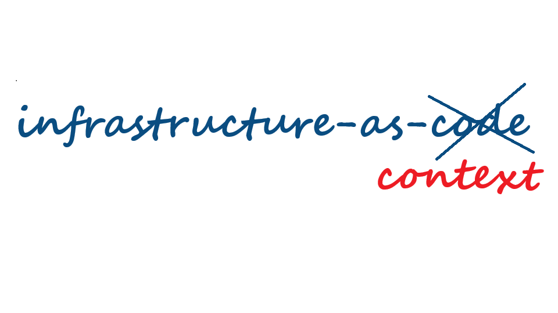
IaC IN THE AGENT ERA
STACKQL>>
Notes:
The agent's context has to be the running estate, not a plan file.

Slide 8
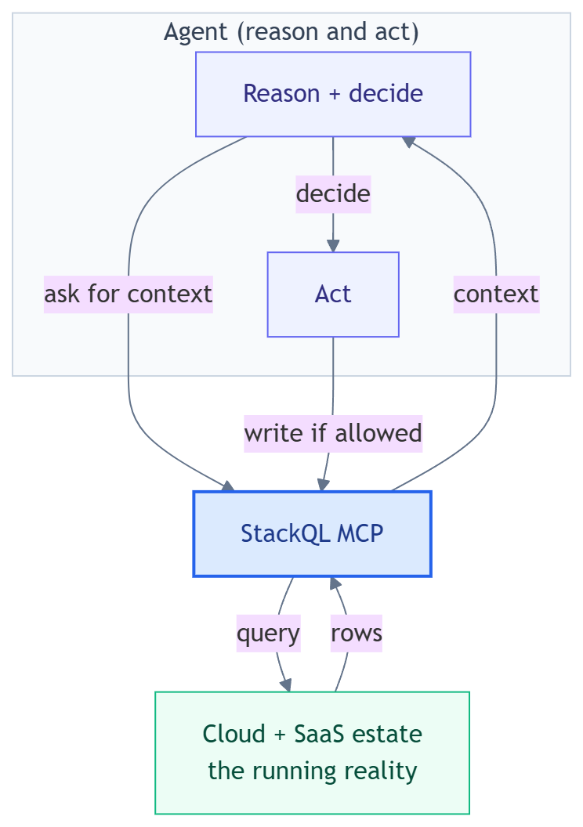
THE NEW CONTRACT
Agents need to query, reason about, and act on actual state.
Static state and state files are artefacts of slow infrastructure.
STACKQL>>
Notes:
with Infrastructure-as-Code: the intent lived in the code.
with Infrastructure-as-Context: agents need to query, reason about, and act on actual state.
Code does not disappear. It - along with the state file - just stops being the contract.

Slide 9
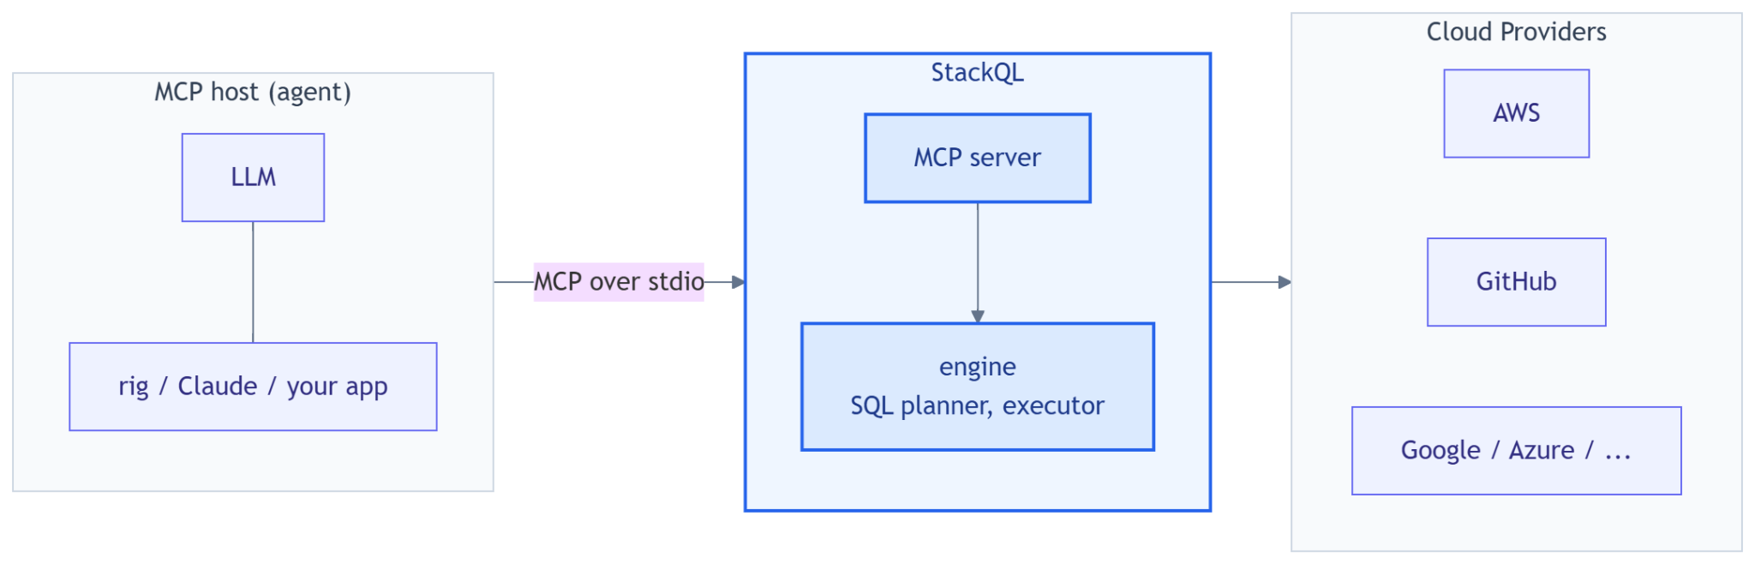
WHAT THE STACKQL MCP SERVER IS
Unified SQL surface over every cloud and SaaS provider.
STACKQL>>
Notes:
One MCP server, one SQL surface, every provider. Instead of N bespoke tool servers with N auth schemes.
Runs over stdio or HTTP; the host here is our own Rust app, but it is the same server Claude Desktop, Cursor, npx and uvx users run.
Credentials stay server-side in the process environment; the model never sees them.

Slide 10
STACKQL MCP TOOL SURFACE
One MCP, one set of tools, instead of 10s or 100s
Discovery: list_providers, list_services, list_resources, describe_resource, describe_method, list_methods, list_registry, pull_provider, server_info
Query (reads): run_select_query, validate_select_query
Change (writes): run_mutation_query, run_lifecycle_operation
changes gated through server modes: read_only (default), safe & delete_safe (uses elicitation), full_access
all tool use is logged by the stackql mcp server
STACKQL>>
Notes:
Discovery tools let the model drill provider -> service -> resource -> methods before writing SQL, so it does not guess table names.
Modes are a server-side contract: `read_only` refuses writes however the model is prompted; `safe` and `delete_safe` send an MCP elicitation request and wait for a human; a client that cannot answer gets a refusal. `full_access` is the explicit opt-in.
Every tool call is audited as JSONL (SQL, decision, duration; never result rows).

Slide 11
CONTROLS BELONG IN THE PROCESS
The prompt proposes; deterministic boundaries decide
TOOL CONTRACT
Strict schema and allowlist
Unknown tools and extra fields are denied.
READ SCOPE
Read-only identity and target scope
Evidence comes from the named fixture.
CHANGE SCOPE
One operation, approved value only
No arbitrary SQL or generic patch.
APPROVAL
Exact plan, operator, and expiry
Fixture identity is self-attested - not production auth.
VERIFICATION
Fresh post-change read
Uncertain outcomes are inspected, never blindly retried.
STACKQL>>

Slide 12
DEMO
STACKQL>>

Slide 13
FOUR-MINUTE DEMO
FIXTURE REPLAY - no live model or cluster call
01 QUERY
Read inventory, desired image, resource version, and evidence ID.
02 DENY
Try an arbitrary target/value; policy denies and stops that action.
03 PROPOSE
Start a separate exact-image proposal using fresh evidence.
04 APPROVE
Review the canonical plan; local approval is teaching-only.
05 VERIFY
Apply one in-memory fixture change and read back the result.
STACKQL>>

Slide 14
OPERATE IT LIKE A WORKLOAD
An agent has runtime, identity, and evidence requirements
IDENTITY AND SCOPE
BOUNDED EXECUTION
Separate read-only and approved mutation identities. Use explicitly scoped credentials; never inherit a developer default context.
Bound turns, output, time, and tool calls. Provider API limits are separate spend controls.
AUDIT EVIDENCE
SAFE CLEANUP
Correlate structured events. Local logs are not durable evidence unless storage and retention are proven.
Reset only positively identified lab-owned resources. The checked-in CronJob is suspended and read-only.
STACKQL>>

Slide 15
WHAT THIS DOES NOT SOLVE
Guardrails reduce risk; they do not make the system infallible
WRONG DESIRED STATE
TIME-OF-CHECK / USE
An approved artifact can itself be stale or incorrect.
A preflight read is not an atomic lock; state may change.
UNTRUSTED INPUT
PRODUCTION READINESS
Prompt injection and hostile tool output remain possible.
Fixture approval, RBAC, durability, and live adapters remain unproven.
STACKQL>>

Slide 16
BEFORE AN AGENT MAY WRITE
Five questions for the platform team
Can it show fresh evidence and an authoritative desired value?
Is the operation narrower than a generic patch or SQL tool?
Can the read identity mutate? (It must not.)
Is approval authenticated and bound to the exact plan and expiry?
Is the result verified without a blind retry?
STACKQL>>

Slide 17



CLOUD
COMPLIANCE
SECURITY
MCP
AUTOMATION
ASSURANCE
THANK YOU
STACKQL>>
stackql.io

